Slide 1
Charting your
club’s future
Kiwanis International
Strategic Plan
Notes:
NOTE: THIS PRESENTATION GOES WITH THE CLUB PLANNING TOOL WORKBOOK FOUND ON THE WEBSITE AS WELL.
Welcome! Today’s presentation will help you prepare your club’s strategic plan in a way that aligns with the organization’s strategic plan. Our purpose here is to help you begin charting your club's journey into the future. You'll be provided the tools to continue the process with your club.
(Introduce yourself and your role with Kiwanis)
(Cover any logistics such as agenda, where we’ll eat, breaks, bathrooms, phones off, etc. as necessary.
You may want to note during the presentation there will be numbers on the slide that correspond to workbook pages.)

Slide 2
Introductions
Why did I join?
Why do I stay?
Notes:
Activity:
Have attendees share with two other people, from other clubs, their answers to the following questions.
CLICK
Why did you join Kiwanis?
Why have you stayed in Kiwanis?
After they have shared their responses individually, have 3 or 4 people share their responses with the entire group.
The reasons people initially join a Kiwanis club may vary widely: to meet new people, recruited by employer, to network, etc. But the reasons why people stay in Kiwanis tend to be connected to the mission of Kiwanis.
Later, we will take a look at planning the future of your club to ensure that what you do in your community is consistent with why your Kiwanis club exists.

Slide 3
Today’s objectives
Understand the strategic plan.
Evaluate your club.
Create goals and strategies.
Apply best practices.
Learn about available resources.
Notes:
The objectives for the session are that you will: [CLICK]
Understand the overall Kiwanis International strategic plan and its four priorities. [CLICK]
Be able to evaluate your own club using Achieving Club Excellence tools and other resources. [CLICK]
Be able to work with other members of your club to create goals and strategies for your club in the four priority areas of the strategic plan. [CLICK]
Learn and be able to apply some best practices of developing and implementing a club strategic plan. [CLICK]
Learn where and how to access and use resources available from Kiwanis International.
Our hope is that you leave with a document in your hand that you can work with to complete your plan when you return home.

Slide 4
Getting started
1
Your club’s planning committee.
Select 5 − 6 people.
Diverse
Committed
Strong contributors
Notes:
So how do you get started with developing your club’s strategic plan?
CLICK
Choose 5-6 people from your club. There are a few things to keep in mind when you choose them. First, the planning committee needs to represent the diversity in your club in background, experience, age, gender, talents and views.
This group of people will need to be committed to mission and purpose of the organization and your club. As your club board begins to discuss the year’s work and the committees start their planning, consider who would be a strong contributor to developing your club’s strategic plan.
As a club leader, you should be very involved in this process. You will receive communications from the district and Kiwanis International about club strategic plans. And you will need to be the leader you were elected to be as these discussions take place.
But remember, you are not alone. There are resources available online to help educate your members on the Kiwanis International plan.

Slide 5
1. Create the vision
2
Start with the end in mind.
Know where you want to go before you develop your plan.
Notes:
The first step in planning is to start with the end in mind. You need to know where you want to go before you can develop your plan to take you there.
Activity: Take a few minutes (at your table) to discuss where you wish your club to be in 5 years. What do you want it to look like, sound like, feel like? How many members and how many children served? Do you want to see membership increase of 5 percent? 10 percent? Do you want better local/community recognition? Do you hope to be able to readily fund a project?
Share some of your thoughts with another person near you and jot down some ideas on the notes page of the handout. We will use these ideas in just a few minutes.
Now that you have an idea of where you want to go... let’s talk about how can you get there.

Slide 6
“If you want to go fast, go alone. If you want to go far, go together.”
~African proverb
Notes:
At Kiwanis International, we also realized that if we wish to move the cause of children’s needs along in the communities we were going to need to move in coordination together. As the old African proverb says, “If you want to go fast, go alone. If you want to go far, go together.”

Slide 7
Motto
Serving the Children
of the World
Notes:
Kiwanis International has a vision of our organization’s future.
It is stated in our motto.
Since 2005 our motto has been “Serving the Children of the World”.
This is our purpose as an organization.
How does your reason for being in Kiwanis relate to the motto of Kiwanis International: Serving the Children of the World?

Slide 8
Defining Statement
Kiwanis is a global organization of volunteers dedicated to improving the world one child and one community at a time.
Notes:
Our defining statement…Kiwanis is a global organization of volunteers dedicated to improving* the world one child and one community at a time.
This how we achieve our purpose... working together for a common purpose.
*”improving” replaced “changing”

Slide 9
Vision
Kiwanis will be a positive influence in communities worldwide…
So that one day, all children will wake up in communities that believe in them, nurture them and provide the support they need to thrive.
Notes:
We believe our worldwide presence is important and needed…now more than ever.
Our vision: Kiwanis will be a positive influence in communities worldwide…so that one day, all children will wake up in communities that believe in them, nurture them and provide the support they need to thrive.
What a noble cause. Isn’t that a proud vision, one which you can wrap your arms around?

Slide 10
Vivid Description
Our global network includes a dynamic family of clubs, individual supporters, alumni, donors, NGO partners and corporate sponsors.
Every community around the world has an opportunity to participate in or benefit from a Kiwanis experience.
Based upon a legacy of service, this global network is dedicated to building community and improving lives by providing opportunities for service, fellowship, leadership, and philanthropy according to local needs, cultures, and member interests.
Notes:
So how do we see our future?
CLICK
Our global network includes a dynamic family of clubs, individual supporters, alumni, donors, NGO* partners and corporate sponsors.
CLICK
Every community around the world has an opportunity to participate in or benefit from** a Kiwanis experience.
CLICK
Based upon a legacy of service, this global network is dedicated to building community and improving lives by providing opportunities for service, fellowship, leadership, and philanthropy according to local needs, cultures, and member interests.
CLICK
Again, this paints a vibrant future for Kiwanis worldwide, a future that starts right in your very own club.
As Kiwanis works toward the organization this describes, what will we hear people saying about us?
(*NGO= non-governmental organizations—name for non-profits outside the US
**”participate in or benefit from” meaning the community may have a Kiwanis club presence or may have received support from a club (i.e., vaccinations for Eliminate, etc.))

Slide 11
Your club’s vision
What is your club’s vivid description?
Notes:
(Exercise - Refer to page two of the strategic plan document.)
What is your club’s vivid description?
Instead of writing a vivid description right now, write descriptors of what you would like to hear, see and feel regarding your club five years from now.
Once you have written 3 to 5 descriptors, share them with your neighbor and gather some more descriptors. You will now have the key words, terms and concepts that will be included in your vision statement and vivid description.

Slide 12
The Kiwanis International Strategic Plan
Notes:
Think of a strategic plan as an organization’s road map. Your can choose the roads you want to take, but the strategic plan ensures you reach your destination...your goals.
A strategic plan is essential for success, and creating a strategic plan that you can actually use is key. Your plan should include certain elements, like mission, values, and vision statements, and avoid common pitfalls, like neglecting the specific needs of your organization, so it becomes your road map for success.

Slide 13
The strategic planning process
Where are we now?
Where are we going?
How will we get there?
Notes:
Strategic planning has a basic overall framework. Not to oversimplify the strategic planning process, but by placing all the parts of a plan into the following three areas, you can clearly see how the pieces of your plan fit together:
Where are we now?
Where are we going?
How will we get there?
Implementation is the phase that turns strategies and plans into actions in order to accomplish strategic objectives and goals. The critical actions move a strategic plan from a document that sits on the shelf to actions that drive business growth. Use a facilitator, if your budget allows.

Slide 14
Effective planning
Reframes
Refocuses
Renews
Re-energizes
Notes:
So why plan?
Planning can reframe, refocus, renew and re-energize a club. After a while things at the club level can fall into patterns and we do things without even examining why we do them.
CLICK
Reframe- Planning can pull a club together. Clubs that have had declining membership cannot provide the same level of community support as in the past. The sad part of this is that as member numbers decrease the needs of children are increasing. Kids need Kiwanis now more than ever. It’s time to pull together!
CLICK
Refocus- Planning together releases new ideas, new energy and a laser focus on what’s needed.
CLICK
Renew- Planning can bring out the best in people, processes and purpose. Working together, club members can better appreciate the insights, experiences, talents and skills that each of them brings to Kiwanis.
CLICK
Re-energize- Planning can be fun! When different worlds collide the results can be very productive and very exciting. Ideas generated will make you laugh, make you scratch your head and think, and make you wonder what that person had for breakfast. Planning for our future is a huge responsibility and one that can generate fun along the way.
Let’s work together to create a plan for your club that you can take back, complete and use to energize your own Kiwanians and communities for our children.

Slide 15
The four priority areas
Membership and Engagement
Community Impact
Our Kiwanis Image
Financial Viability
Notes:
We have centered our efforts in four priority areas.
Our goal today is to educate about the Kiwanis strategic plan so that you can help clubs understand the plan and the direction in which we will move forward in our communities. So let’s take a look at this plan in a more detailed way.
What are these common Kiwanis goal areas?
Membership and engagement
Community impact
Our Kiwanis image
Financial viability
All four of these are important and needed at every level. Each priority area supports the other three!!

Slide 16
Four important concepts
Kiwanis network of service
Kiwanis community
Signature project
Service Leadership Programs as partners
Notes:
Woven throughout the plan you’ll see four important concepts as well.
CLICK
The first is the formation of a Kiwanis network of service. In order to improve the lives of children and communities we will need others to help us. This network of service will help us expand our service with extra hands and extra resources. It’s here that Kiwanis can become the catalyst for positive change in our communities by pulling all interested parties together in a common goal.
CLICK
The second is the concept of the Kiwanis community. So what does a Kiwanis community look like? We see it as a local network of Kiwanis family clubs, supporters, donors, SLP alumni, for-profit and not-for-profit organizations, and others including governments, educational institutions and others that work together under the Kiwanis name. Our Kiwanis network helps lead to a Kiwanis community.
CLICK
The third concept is that of a signature project in each of our clubs. A signature project is 1) annual or reoccurring, 2) high impact (the project should have a demonstrable positive impact on the community measurable in monies raised, children served, flags hung, playgrounds built, etc.), 3) brand-enhancing (the project should be designed to elevate the brand identity of Kiwanis in the local community with opportunities for public relations activities such as Kiwanis naming rights, media inclusions, etc.), and 4) is membership focused (should support opportunities to strengthen membership and develop new partnerships).
CLICK
And the last concept involves our Service Leadership Program participants. It’s time for us to recognize these young leaders and our other K family members as our “partners” in service. The SLP clubs and members, including K-Kids, Builders, Key Club, Circle K and Aktion Clubs in addition to Key Leader, Bring Up Grades and Terrific Kids, need to be recognized and appreciated as full-fledged partners in service as part of the global and community Kiwanis networks.

Slide 17
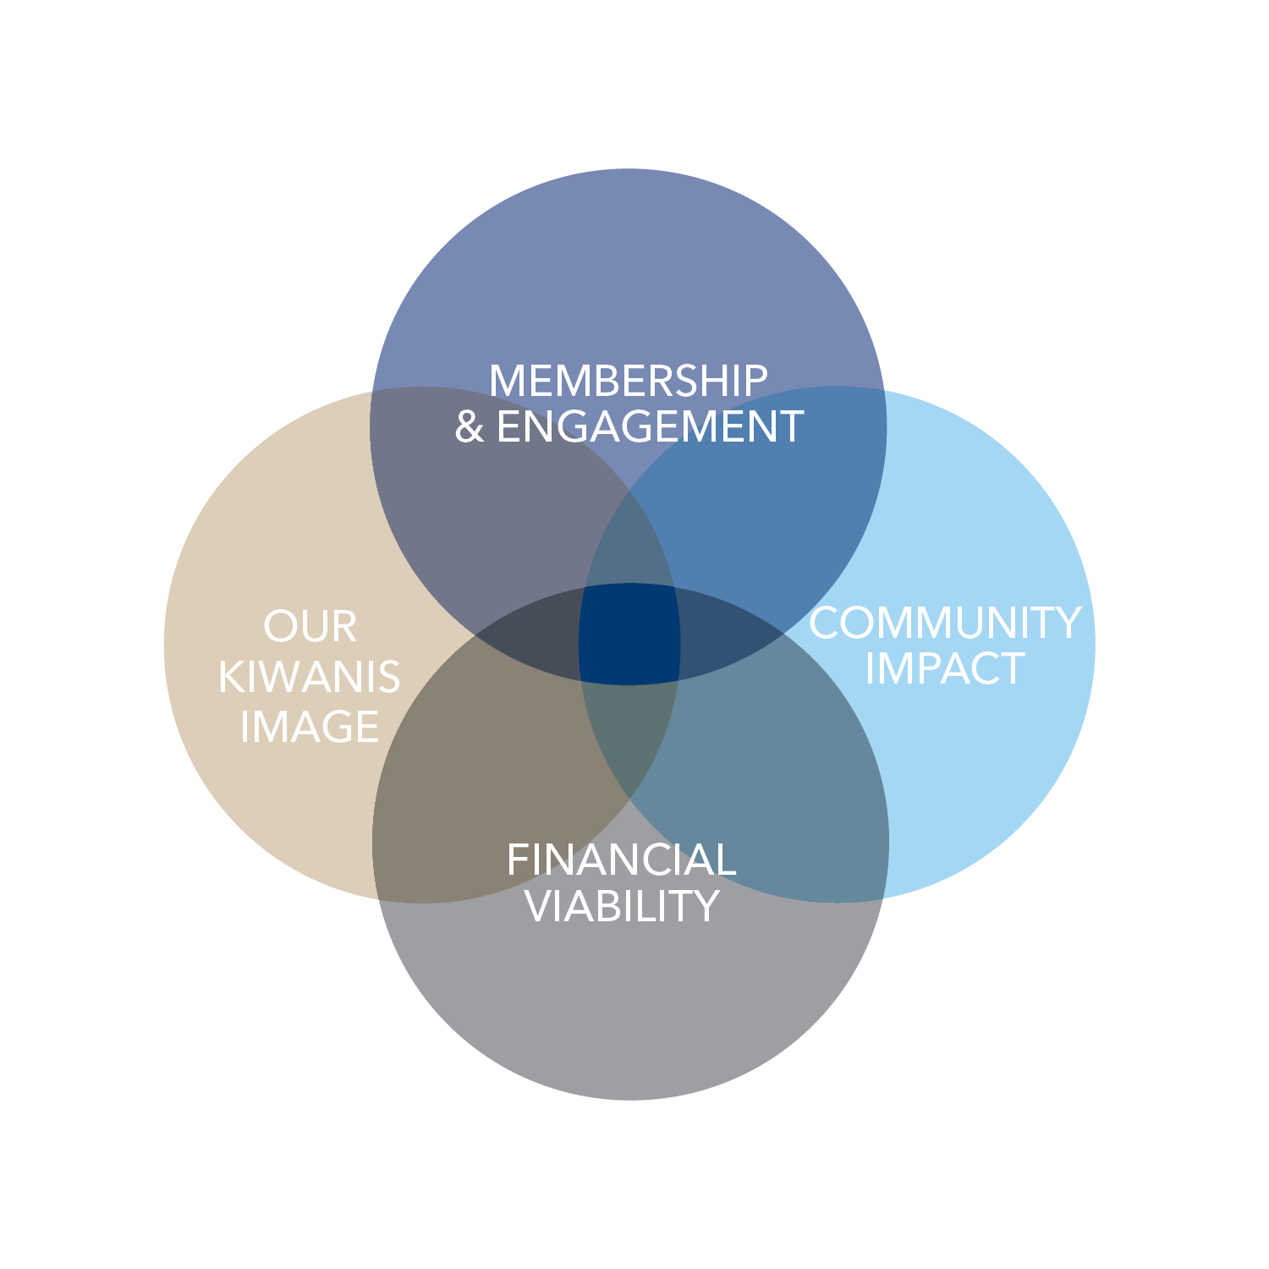
The results
Notes:
A strategic plan can shed light on an organization’s unique strengths and relevant weaknesses, enabling it to pinpoint new opportunities or the causes of current or projected problems.
With commitment from within the organization to the plan’s implementation, a strategic plan can provide an invaluable blueprint for growth and revitalization, enabling an organization to take stock of where it is, determine where it wants to go and chart a course to get there.
Through the strategic plan, Kiwanis’ global network is larger than clubs and members. When we connect and collaborate with schools, hospitals, government, other nonprofits, corporations, foundations and others, Kiwanis—and the service we can provide to children—becomes an undeniable force for good in our communities. That means a bigger impact in the world.
That means stronger communities that help children thrive, prosper and grow. Because the world needs happy, healthy, safe children. And kids need Kiwanis.

Slide 18
Global Impact Global Impact Global Impact Global Impact Global Impact
Children Community Children Community Children Community
Notes:
Here’s is what that looks like on a larger scale. CLICK
When clubs see all four priorities [CLICK] as important and begin to build success right into the way they do business, we will have a WIN on our hands.
Then when we see a need and design a solution, we begin to invite others in to join us. CLICK
These others might be other foundations, schools, the local chamber of commerce, other non-profits, hospitals, governmental organizations, corporations, alumni and donors and the result [CLICK] is happier, healthier communities on a local level.
But is doesn’t stop there. [CLICK] We believe the short and long term impact of our strategic plan’s collaborative efforts will be reflected on a global scale.
Kiwanis can be the catalyst for positive changes worldwide!
With these kinds of contacts and partnerships, a club, district, and international organization thrives for years to come. This is where we make communities stronger by connecting many people and organizations together for a greater good.

Slide 19
2. Gather and Analyze
3
Some online ACE tools:
Analyzing your impact
Club scorecard
Creating the purpose
Developing community partnerships
Hosting a membership drive
Measuring member satisfaction
Rediscovering your community
Notes:
By collecting more information, the planning process becomes more effective. That's where ACE comes in. It stands for Achieving Club Excellence. And it gives clubs a set of tools to assist with some of the collection & analysis of information.
What do your members think about your club? – Collect data by asking your members (Measuring member satisfaction).
What are the current and projected needs of your community? Reach out to your community concerning how your club can help (Rediscovering your community’s needs).
Collect your club’s membership data (Club scoreboard and sources)...what has your membership looked like over the last 10 years. Are there trends you want to improve?
Analyze your club’s footprint (Analyzing your impact)
Are your service projects successful? How do we define success? Are these projects as impactful as they could be?
Are you successful with raising funds? Are there better ways? Are you using the money to create greater impact?
What does your community think about your Kiwanis club? Check your image...ask around to determine how your community views your club.
Assess your finances...document your financial resources and determine if the amounts are sufficient for your needs.

Slide 20
Gather and analyze
3
What is happening within your club that makes it strong?
What opportunities does your community offer that can help achieve your club’s vision?
What are the weaknesses within your club that are barriers?
What are the external factors that might hinder your club’s efforts?
Notes:
There are other questions to consider, also.
(Activity- Divide the attendees into smaller groups of 4-6 people. Assign one of the above questions to each group. Allow several minutes for them to answer the questions. After a few minutes, gave groups report briefly on how they answered the questions.)

Slide 21
3. Develop your plan
Determine where you want to go.
Determine strategies and tactics.
Determine what metrics to use.
List action steps and timelines.
Notes:
As you are analyzing all your information, remember to view it through the lens of the four priorities of the Kiwanis International strategic plan:
membership & engagement
community impact
our Kiwanis image
financial viability.
As you begin to plan you need to cover the four key concepts:
Kiwanis community
Service Leadership Programs as partners in service
Kiwanis network of service
your club’s own signature project.
A completed plan will include a goal for each priority based on the needs of your club. It may be similar to KI’s priority goal. What is most important is that it meets your club’s needs.
Determine the strategies you’ll use to accomplish the goals. Your strategies will take the next step to additionally support club goals.
Metrics will be used to measure progress. These will also be your measure of success.
Finally, the goals and strategies need to be passed on to committees or club members that will determine specific action steps to take along the timeline.
Now that’s a fairly progressive game plan.
So let’s get started.

Slide 22
Membership
and Engagement
Notes:
We can do nothing without members. So let’s begin there… with Membership and Engagement

Slide 23
Membership and Engagement
Goal:
To build, retain and support a growing Kiwanis membership network.
Notes:
Our goal is to build, retain and support a growing Kiwanis membership network.
Kiwanis inspires and engages men, women, youth, corporations, other nonprofits, partners and communities to make the world a better place for children to thrive. Belonging to Kiwanis means being a part of a massive force for positive change in the world.
This means opening more clubs, growing existing membership, strengthening the club experience, etc.

Slide 24
Membership and Engagement
What is the goal is your district?
What is the goal of your club?
Goal:
To build, retain and support a growing Kiwanis Club of XXX’s membership network.
Goal:
To build, retain and support a growing Kiwanis membership network.
Notes:
What is the goal is your district?
What is the goal of your club?
What will that look like? It is a world where Kiwanis inspires and engages men, women, youth, corporations, other nonprofits, partners and communities to make the world a better place for children to thrive. It’s a world where belonging to Kiwanis means being a part of a massive force for positive change in the world.
So what is the goal is your club?
[CLICK]
It may very well be the same as Kiwanis International’s, “Build, retain and support a growing Kiwanis membership network.”.
[CLICK]
Or you could edit with your club name, to be “Build, retain and support a growing Kiwanis Club of XXX’s membership network.”.

Slide 25
Metrics for Membership and Engagement
You may want to measure:
Number of members
New members each month
Annual increase in membership
Average age of members
Percent of male/female members
Notes:
Your metrics need to be specific, actionable and realistic.
Some measurements you may want to consider are:
Number of members
New members each month
Annual increase in membership
Average age of members
Percent of male/female members

Slide 26
Let’s try one together
Strategy: Increase membership in our club
How?
Metrics
Timelines
Responsible parties
Notes:
Let’s go through one together as group first.
Here is a strategy for this priority: Increasing membership in your club. As a club, discuss how you would accomplish this. Include measurable items, timelines and the person/position responsible.
(Give them some time to discuss, then have them share out loud. Once you feel they understand the work, have them move onto to tackling all of inspiration.)

Slide 27
3. Develop your plan
4
Overall Priority | Strategies | How will you accomplish the strategy?
Membership and Engagement | KI: Increase membership Club:
Notes:
(Refer attendees to page 4 of their handout.)
These pages in the workbook include Kiwanis International’s goals and strategies for the four priority areas of the plan.
(Allow a few minutes for them to work individually or in small groups to determine strategies for their club that will increase membership, involvement and engagement. Ask the group to share a few of their suggested strategies.)

Slide 28
3. Develop your plan
5
Committee __________________________________ Strategy: ________________________________________ Operational steps to accomplish the strategy
What specifically? | How will you measure? | What date? | Responsible?
Notes:
After determining your club’s goal and strategies for Membership and Engagement, its time to focus on the implementation steps of your plan.
This is a good time to involve key club committees or club members.
Committees should use the form on page 5 of the handout to develop their action steps to support the goals and strategies of the club.
Be sure to include all four aspects of the action:
What specifically will be done?
How will it be measured?
When does it need to be accomplished?
Who is responsible/accountable for the action?

Slide 29
Share ideas
Discuss ideas
and share best practices.
Notes:
(Ask groups or individuals to share specifics from their plans.)
Is there something there that you could use?
Anything you didn’t think of? Anything you could suggest?
Sharing best practices makes us all better.

Slide 30
Community Impact
Notes:
Priority: Community Impact
Our strategic plan is like a puzzle, it takes many pieces in the right place to give you the picture you want. We’ve looked at membership and engagement. Let’s take a look at our next priority area, community impact.

Slide 31
Community Impact
Goal:
To perform meaningful service, with service to children as our priority
Notes:
Our goal is to perform meaningful service, with service to children as our priority.
Kiwanis is best expressed through meaningful service in communities around the world. When we work together and with other organizations to address important needs for children, we change lives, build stronger communities and even improve our own lives.
And what will the community impact goal be in your club? In your community?

Slide 32
Metrics for Community Impact
You may want to measure:
Number and type of signature project
Youth affected
Dollars raised
Dollars spent/given back to the community
Notes:
Our goal is to perform meaningful service, with service to children as our priority.
So what is the goal of your club?
Some measurements that you may want to consider are:
Number and type of signature project
Number of youth served
Dollars raised
Dollars spent/given back to the community

Slide 33
Signature project criteria
Membership
and Partnerships
High impact
Brand-enhancing
Recurring
Notes:
Signature projects are important for the future of Kiwanis, as they can elevate awareness of Kiwanis in local communities and of course put a spotlight on the impact we make.
Recurring, brand-enhancing, high impact along with membership and partnership focused.
These are the keys to creating a successful signature project.
Again, a signature project is one that includes all of the following signature project criteria CLICK:
Recurring: At a minimum, the project should take place annually. CLICK
Brand enhancing: The project should be designed to elevate the Kiwanis brand in the local community with opportunities for public relations activities, such as Kiwanis naming rights, media mentions, etc. CLICK
High impact: The project should have a demonstrable positive impact on the community; this impact should be measurable in monies raised, children served, flags hung, playgrounds built, etc. CLICK
Membership focused: The project should support opportunities to strengthen membership and develop new partnerships. CLICK
It is crucial that all four are taking place.
TIP: A good question to ask when identifying a signature project is “what community activity or event is my club known for?”

Slide 34
Our Kiwanis Image
Notes:
Priority: Our Kiwanis Image
Our goal is to enhance the Kiwanis image worldwide.
Image matters.
Everything we think, say and do is contagious and spreads Kiwanis. Is what we’re spreading worth catching?

Slide 35
Our Kiwanis Image
Goal:
To enhance the Kiwanis image worldwide
Notes:
Priority: Our Kiwanis Image
Our goal is to enhance the Kiwanis image worldwide.
Our image is anything people think or feel about us when they see our logo, our wordmark, hear our name or see a Kiwanian in action.
It’s a reflection of who we are, how we act, what we say, what we print, how we respond.
Everything we think, say and do creates our Kiwanis image
It’s what differentiates us from other people and other organizations.

Slide 36
Metrics for Our Kiwanis Image
Some ways to consider tracking progress:
External audiences targeted/reached
Awards and recognitions earned
Media exposure
Notes:
We’ll track our progress on these action steps by monitoring:
External audiences that we have targeted, and those we have reached
Awards and recognitions
Media exposure
Why do we care so much about our brand?
Because it belongs to all of us. We all need to be good stewards of our brand’s integrity so it can be clear, strong – the bold trigger we need for people to instantly connect our seal and name with a great organization and our amazing work for children! It is how others recognize us.
Let’s spread the word about the good work we do.

Slide 37
What is our current image?
Notes:
Why do we need a refresh and refocus here?
Because we have multiple identities!
And at the end of the day, when you have this many identities...you don't really have any identity.

Slide 38
#KidsNeedKiwanis
Notes:
Here is our new, refreshed look. Easy on the eye, easy to identify, and easy to remember.
Another resource you’ll find helpful in terms of our new branding priority can be found on kiwanis.org/KiwanisOne. You’ll see at the top right a tab that says “Promote Your Club”—when you are looking for communications tools, templates and key messages, this is the first place to turn. You’ll find a page like this that lays out all the resources available to you. This is also where we keep an updated Just The Facts sheet.
You’ll also find a downloadable brand guide on our website and access to our logo in any format you might need. Our brand guide not only explains how to use our brand, but also gives tips—for example, did you know that when you resize an image, if you hold the control button while you drag the corner of the image, it won’t get stretched our or squished? And it explains what not to do. There are a lot of ideas stored there.
Want to take all the guess work out of your logo updates? Kiwanis International will create a custom club logo free of charge! The request form is on the website too.
CLICK
Kids need Kiwanis is an external brand campaign—with our mission at the heart of our brand message. It simply states, kids need Kiwanis.
It’s not about our club structure or bylaws; it’s not about districts and regions. It’s about the kids who need us—and how we help them.
How do Kids Need Kiwanis in your community?

Slide 39
Financial Viability
Notes:
And our final priority: Financial Viability
Our goal is to ensure financial viability and responsible stewardship.
That’s a tall order at every level of the organization.
Financial viability means being good stewards of time, talent and treasure.

Slide 40
Financial Viability
Goal:
To ensure financial viability and responsible stewardship
Notes:
The more financially viable we are, the more children we can help.
Kiwanis does amazing work in the world. When we make wise financial investments, find opportunities to turn profits into service, pool our financial and volunteer resources, create efficient structures and make processes easy and affordable, we can build our capacity to do even more for the children of the world.
Our goal is to ensure financial viability and responsible stewardship.

Slide 41
Metrics for Our Kiwanis Image
A club should consider measuring:
Annual budgets
Amount of service dollars raised/spent
Partnership revenue
New revenue (new fundraisers)
Membership dues
Notes:
That is a tall order at every level of the organization.
What will your club measure to track your progress on action steps in this area?
Adopt and follow annual budgets for service and administration
Increase in service dollars raised
Increase in revenue from community partnerships
Amount of new revenue (new fundraisers)
Control and monitor membership dues

Slide 42
4. Communicate the plan
12
Design a plan overview of club goals.
Announce the plan to club members.
Prepare the “hand-off checklist” for club committees.
Notes:
Communicating the plan is critically important to keep everyone involved and focused.
The first step to communicating your club’s strategic plan is to format it in a way that makes it easy to share. Design a one-page summary of the plan listing the major goals in each of the four areas of the plan. (There is a downloadable, fillable PDF file for this use on the website.) Additional ideas might include: create a poster of this one-page summary to post at club meetings, print in the club newsletter, and post on the club website.
Be sure to have copies of the plan available at each month’s board meeting for review.
Create a “hand-off checklist” of the key areas of the plan for continuity between administrative years and changes in club leadership.

Slide 43
4. Communicate the plan
12
Share the plan.
Get everyone on board.
Notes:
Now you have the basic framework for your club’s strategic plan. But this is just the beginning.
There are some more, equally crucial steps your club needs to do to ensure success. For example: Share the plan – get everyone on board.
A key step is to involve the club committees in the implementation of the plan.

Slide 44
4. Communicate the plan
12
SMART action items:
Specific
Measurable
Actionable
Realistic
Time bound
Notes:
To achieve the club’s goals, each committee should create supportive SMART (specific, measurable, actionable, realistic and time bound) action items annually.
Using the club plan as a guide, each committee can create action steps and then assign specific tasks to committee or club members.

Slide 45
5. Implement the plan
12
After approval, consider following these steps:
Assign responsibilities.
Review or create job positions.
Invest.
Regular updates goals.
Review monthly.
Keep the plan and milestones visible.
Notes:
After the club board of directors approves the plan, assign board members to oversee the specific areas of the plan. In addition, use the following guidelines to ensure that your club strategic plan is well executed:
• Assign committees or club members to be accountable for the results.
• Review or create job positions in your club with assigned responsibilities to support the plan.
• Invest the necessary resources (money and manpower) to achieve results.
• Require regular updates from committees on status and progress toward goals.
• Regularly review progress at monthly board meetings.
• Keep the goals of the plan and milestone achievements visible

Slide 46
6. Measure results
13
Track outcomes not outputs
Use tools to record metrics
Assess progress at board and club meetings
Review the plan – adjust if needed
Share results and lessons learned
Notes:
Milestones are checkpoints of your progress toward your goals.
Keep in mind that milestones are not measures of activity, but preliminary achievements of your plan. In other words, track outcomes, not outputs.
For example: Your club goal is to increase membership by 10 percent. Hosting a guest day at a club meeting is an activity. The milestone to measure is how many of those attending the guest day joined the club.

Slide 47
Plan alternate routes
13
What do you see as your roadblocks?
What will stop you from succeeding?
What can you do about it?
Evaluate your club’s plan; going the wrong direction?
Revisit your strategy or reconsider milestones.
Communicate your evaluation results.
Who might benefit from what you’ve learned?
Notes:
Your plan is on the way.
CLICK
What do you see as your roadblocks?
What will stop you from succeeding?
What can you do about it?
Sometimes plans do not get the desired results. If after evaluating your club’s plan for a few months you find that you are going nowhere or in the wrong direction, you will need to revisit your strategy or reconsider milestones.
Communicate your evaluation results. An important part of the strategic plan process is sharing the lessons you have learned. Think who might benefit from what your club has learned through the planning and implementation process.

Slide 48
7. Celebrate sucess
13
Remember to celebrate!
You, your members and partners have worked hard.
Recognize them!
Celebrate them!
Notes:
Remember to celebrate! Your club’s members have worked hard to make your club successful. If your club doesn’t have an annual celebration, consider planning a formal or social event that is filled with fun, fellowship and recognition.
There’s no need to wait. Recognize a job well done.
Recognition is most effective when it is frequent and immediate.
Recognize your community partners.
Many of the successes in your Kiwanis club are the result of the relationships and partnerships your club has developed to support large-scale projects. Acknowledge your club’s partners and sponsors to:
•Inspire others to become involved.
•Build community support for future initiatives.
•Emphasize community service.
•Offer opportunities to highlight community issues.
•Demonstrate that one person can be an effective agent for change.
•Make those engaged in service feel that they and their work is valued.
•Provide examples for the rest of the community.

Slide 49
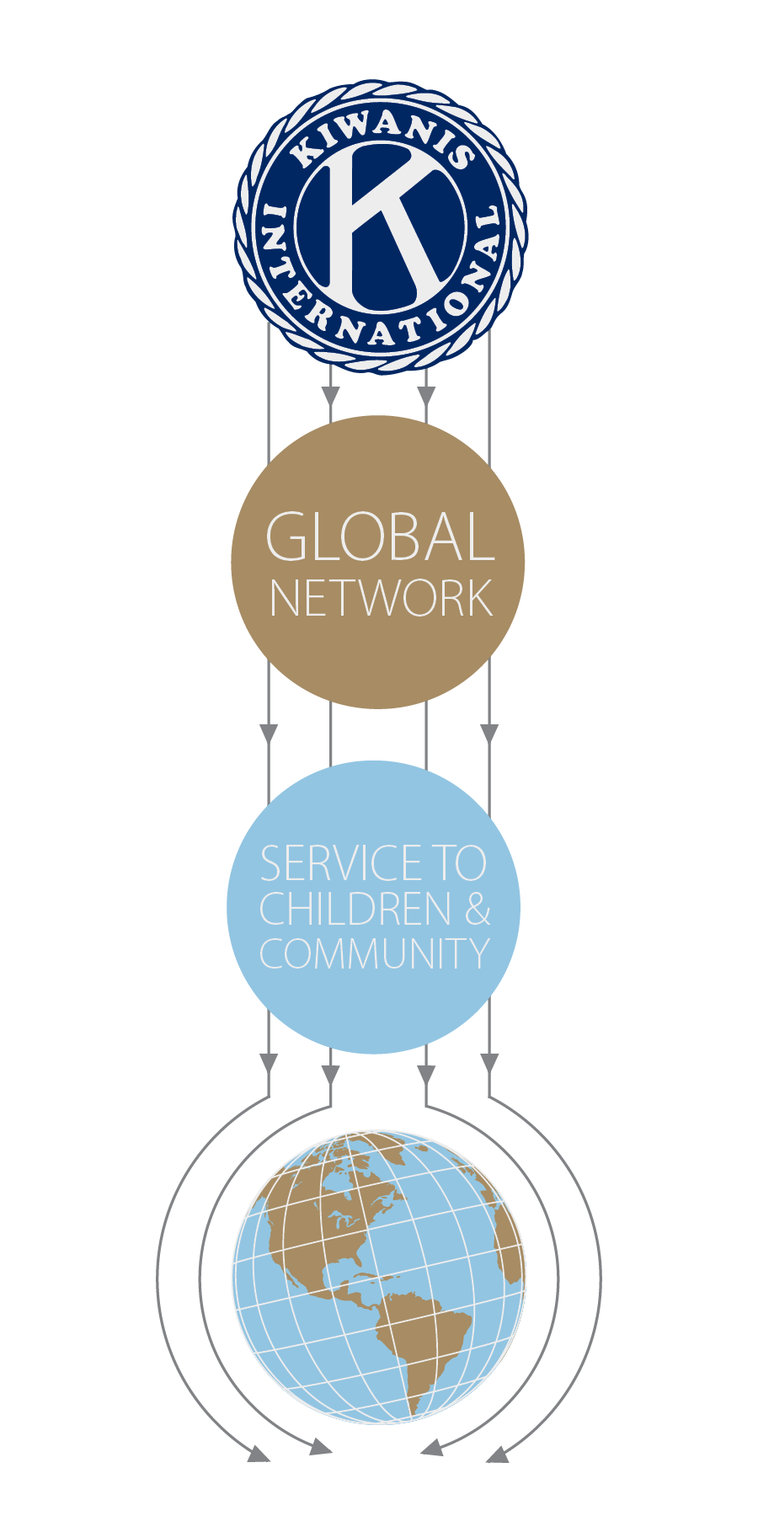
The four priority areas
Notes:
This is where the magic happens.
[CLICK]
This is where Kiwanis becomes the catalyst for positive community change. Where all the priorities converge.
When we connect and collaborate with schools, hospitals, government, other nonprofits, corporations, foundations and others, Kiwanis—and the service we can provide to children—becomes an undeniable force for good in our communities. That means a bigger impact in the world. That means stronger communities that nurture their children.
Because the world needs happy, healthy children. And kids need Kiwanis.

Slide 50
Next steps
14
Complete the plan.
Set your club on the path to future success.
Notes:
Now you understand the purpose and structure of the strategic plan. You have also had an opportunity to conduct an analysis of your club and to look at ways to protect your club from threats, take advantage of opportunities, leverage your strengths and minimize your weaknesses.
You have even begun the process of defining your goals, priorities and metrics.
So, what’s next?
Go back to your club, with its leadership and members. Complete a plan that creates a vibrant guide to your shared vision.
With your club’s strategic plan as a roadmap, every year your club can create a plan for the upcoming year to move along your club’s path to a successful future.

Slide 51
Questions and discussion
Notes:
Questions and Discussion
(Go through any follow up questions. Then click.)

Slide 52
Thank you!
Notes:
(end slide)
Thank you for what you do for children and what you WILL do for children. Now let’s go out and make Kiwanis proud.
Kiwanis provides positive impact in communities and the lives of children.
After all, kids need Kiwanis.

Slide 53
Delete this slide if we do not update video.
Strategic Plan
Overview Video
Notes:
(show video…Kiwanis’ Overall Strategic Plan video 1:31 minutes in length)

