Slide 1
Kiwanis International Strategic Plan
Notes:
Welcome!
This is an overview presentation of Kiwanis International’s strategic plan.
(Introduce yourself and your role with Kiwanis)

Slide 2
Future
Now
Notes:
The planning for today began in January 2012. The Kiwanis International Board began collecting the strategic plans from all parts of our Kiwanis family in order to align them all into one organizational strategic plan. The hope was to find all of our plans accomplished similar goals and were beautifully in sync.
[CLICK]
We discovered the that was not the case.
We found was that each year at each level of Kiwanis we progressed more like this.
Many had no plans at all, others’ plans were simply to survive, and in the majority of the plans the end product goals changed every single year. In today’s rapidly changing environment we realized we need to operate much differently if we wish to thrive and continue serving the children of the world for another century.

Slide 3
Quick history
2012 2017
Personal interviews and focus groups
Kiwanis International
Kiwanis International Foundation (now the Children’s Fund)
Kiwanis International European Federation
Kiwanis International Asia-Pacific
Key Club International
Circle K International
Districts
Clubs
Notes:
June of 2012 consultants began meeting and interviewing board members of Kiwanis International, Kiwanis International Foundation, Kiwanis International European Federation, Asia-Pacific, Circle K, and Key Club International.
[CLICK]
Personal interviews, surveys and focus groups with both Kiwanis and non-Kiwanis participants worldwide were conducted to find out what is important in today’s world regarding our focus, our delivery and our cause. In 2013 the board began taking all the collected information to create a new vision.
The Kiwanis International board approved this new strategic plan, in April 2014. It was presented to Kiwanis International Foundation/now the Kiwanis Children’s Fund, Kiwanis International European Federation, Kiwanis Asia-Pacific, Key Club International, Circle K International, Governors, Governors-elect, and District teams. Communication to clubs continues as they develop and aligned their strategic plans.

Slide 4
B
Future
Now
A
Notes:
Our Kiwanis organizational goal is to have every part of Kiwanis family using a unified strategic plan model, to progress efficiently from Point A to Point B,
[CLICK]
with goals and action plans that are unique to their area and support the four priorities, all moving in a similar direction, perhaps getting there in slightly different ways. Yet all heading to the same place. Together.

Slide 5
If you want to go fast, go alone. If you want to go far, go together.”
~ African proverb
Notes:
We also realized that if we wish to move the cause of children’s needs along in the communities we were going to need to move in coordination together. As the old African proverb says, “If you want to go fast, go alone. If you want to go far, go together.”

Slide 6
Motto
Serving the Children
of the World
Notes:
Since 2005 our Motto has been and remains “Serving the Children of the World”.
Think about it, how do YOU and YOUR club serve the children of the world?

Slide 7
Defining Statement
Kiwanis is a global organization of volunteers dedicated to improving the world one child and one community at a time.
Notes:
Our defining statement…Kiwanis is a global organization of volunteers dedicated to improving* the world one child and one community at a time.
This is how we achieve our purpose... working together.
*”improving” replaced “changing”

Slide 8
Vision
Kiwanis will be a positive influence in communities worldwide…
So that one day, all children will wake up in communities that believe in them, nurture them and provide the support they need to thrive.
Notes:
We believe our worldwide presence is important and needed…now more than ever.
Our vision: Kiwanis will be a positive influence in communities worldwide…so that one day, all children will wake up in communities that believe in them, nurture them and provide the support they need to thrive.
What a noble cause. Isn’t that a proud vision, one which you can wrap your arms around?

Slide 9
The Kiwanis International Strategic Plan
Notes:
Think of a strategic plan as an organization’s road map. Your can choose the roads you want to take, but the strategic plan ensures you reach your destination...your goals.
A strategic plan is essential for success, and creating a strategic plan that you can actually use is key. Your plan should include certain elements, like mission, values, and vision statements, and avoid common pitfalls, like neglecting the specific needs of your organization, so it becomes your road map for success.
Strategic planning has a basic overall framework. Not to oversimplify the strategic planning process, but by placing all the parts of a plan into the following three areas, you can clearly see how the pieces of your plan fit together:
Where are we now?
Where are we going?
How will we get there?
Implementation is the phase that turns strategies and plans into actions in order to accomplish strategic objectives and goals. The critical actions move a strategic plan from a document that sits on the shelf to actions that drive business growth. Use a facilitator, if your budget allows.

Slide 10
Four important concepts
Kiwanis network of service
Kiwanis community
Signature project
Service Leadership Programs as partners
Notes:
Woven throughout the plan you’ll see four important concepts as well.
CLICK
The first is the formation of a Kiwanis network of service. In order to improve the lives of children and communities we will need others to help us. This network of service will help us expand our service with extra hands and extra resources. It’s here that Kiwanis can become the catalyst for positive change in our communities by pulling all interested parties together in a common goal.
CLICK
The second is the concept of the Kiwanis community. So what does a Kiwanis community look like? We see it as a local network of Kiwanis family clubs, supporters, donors, SLP alumni, for-profit and not-for-profit organizations, and others including governments, educational institutions and others that work together under the Kiwanis name. Our Kiwanis network helps lead to a Kiwanis community.
CLICK
The third concept is that of a signature project in each of our clubs. A signature project is 1) annual or reoccurring, 2) high impact (the project should have a demonstrable positive impact on the community measurable in monies raised, children served, flags hung, playgrounds built, etc.), 3) brand-enhancing (the project should be designed to elevate the brand identity of Kiwanis in the local community with opportunities for public relations activities such as Kiwanis naming rights, media inclusions, etc.), and 4) is membership focused (should support opportunities to strengthen membership and develop new partnerships).
CLICK
And the last concept involves our Service Leadership Program participants. It’s time for us to recognize these young leaders and our other K family members as our “partners” in service. The SLP clubs and members, including K-Kids, Builders, Key Club, Circle K and Aktion Clubs in addition to Key Leader, Bring Up Grades and Terrific Kids, need to be recognized and appreciated as full-fledged partners in service as part of the global and community Kiwanis networks.

Slide 11
The four priority areas
Membership and Engagement
Community Impact
Our Kiwanis Image
Financial Viability
Notes:
We have centered our efforts in four priority areas.
Our goal today is to educate about the Kiwanis strategic plan so that you can help clubs understand the plan and the direction in which we will move forward in our communities. So let’s take a look at this plan in a more detailed way.
So what are these common Kiwanis goal areas?
Membership and engagement
Community impact
Our Kiwanis image
Financial viability
All four of these are important and needed at every level. Each priority area supports the other three!!

Slide 12
Membership
and Engagement
Notes:
We can do nothing with out members. So let’s begin there… with Membership and Engagement

Slide 13
Membership and Engagement
Goal: To build, retain and support a growing Kiwanis membership network
Notes:
Our goal is to build, retain and support a growing Kiwanis membership network.
Kiwanis inspires and engages men, women, youth, corporations, other nonprofits, partners and communities to make the world a better place for children to thrive. Belonging to Kiwanis means being a part of a massive force for positive change in the world.
This means opening more clubs, growing existing membership, strengthening the club experience, etc.
What is the goal in your district? What is the goal of your club?

Slide 14
Strategies for Membership and Engagement
Increase membership
Open clubs
Develop leaders
Invite and build with a service focus
Increase the value of the member experience
Build a strong network of local and global partners
Notes:
Here are some strategies the Kiwanis International Board created to build, retain and support our growing Kiwanis membership network.
(these are downloadable brochure)
Increase membership
Strengthen traditional membership that meets in the traditional club format.
Research, develop and grow our non-traditional membership like club satellites, 3-2-1 clubs and new models yet to come.
Open clubs (worldwide)
Develop leaders (at all levels)
Focus on the strategic plan; this will improve the member experience as well as create a leadership pipeline at multiple levels.
Invite new members
Increase the value of the member experience
Build a strong network of local and global partners (in service as well as funding)

Slide 15
Community Impact
Notes:
Priority: Community Impact
Our strategic plan is like a puzzle, it takes many pieces in the right place to give you the picture you want. We’ve looked at membership and engagement. Let’s take a look at our next priority area, community impact.

Slide 16
Community Impact
Goal: To perform meaningful service, with service to children as our priority
Notes:
Our goal is to perform meaningful service, with service to children as our priority.
Kiwanis is best expressed through meaningful service in communities around the world. When we work together and with other organizations to address important needs for children, we change lives, build stronger communities and even improve our own lives.
And what will the impact goal be in your district? In your club? In your community?

Slide 17
Strategies for Community Impact
Empower and support growth in our Service Leadership Programs
Align relevant service with community needs
Encourage the development of a signature project in each club
Encourage hands-on service projects
Notes:
(Again, these are in the brochure)
Kiwanis International Board’s strategies include
Empower and support growth in our Service Leadership Programs
Align relevant service with community needs.
From the KI perspective we are really emphasizing finding what the community really needs, not what you THINK the community needs.
Encourage the development of a signature project in each club
We plan to maximize our use of technology to support Kiwanis community networks and signature projects.
We plan to maximize our internal and external resources to support networks, signature projects and partnerships
Encourage hands-on service projects

Slide 18
Signature project criteria
Membership
and Partnerships
High impact
Brand-enhancing
Recurring
Notes:
Signature projects are important for the future of Kiwanis, as they can elevate awareness of Kiwanis in local communities and of course put a spotlight on the impact we make.
Recurring, brand-enhancing, high impact along with membership and partnership focused.
These are the keys to creating a successful signature project.
Again, a signature project is one that includes all of the following signature project criteria CLICK:
Recurring: At a minimum, the project should take place annually. CLICK
Brand enhancing: The project should be designed to elevate the Kiwanis brand in the local community with opportunities for public relations activities, such as Kiwanis naming rights, media mentions, etc. CLICK
High impact: The project should have a demonstrable positive impact on the community; this impact should be measurable in monies raised, children served, flags hung, playgrounds built, etc. CLICK
Membership focused: The project should support opportunities to strengthen membership and develop new partnerships. CLICK
It is crucial that all four are taking place.
TIP: A good question to ask when identifying a signature project is “what community activity or event is my club known for?”

Slide 19
Our Kiwanis Image
Notes:
Priority: Our Kiwanis Image
Our goal is to enhance the Kiwanis image worldwide.
Image matters.

Slide 20
Our Kiwanis Image
Goal: To enhance the Kiwanis image worldwide
Notes:
Priority: Our Kiwanis Image
Our goal is to enhance the Kiwanis image worldwide.
What is the Kiwanis image? Our image is anything people think or feel about us when they see our logo, our wordmark, hear our name or see a Kiwanian in action.
It’s a reflection of who we are, how we act, what we say, what we print, how we respond.
Everything we think, say and do creates our Kiwanis image
It’s what differentiates us from other people and other organizations.

Slide 21
Strategies for Our Kiwanis Image
Increase name recognition worldwide
Increase knowledge of our mission
Unify all Kiwanis brands
Promote the Kiwanis vision and vivid description
Promote signature projects
Notes:
Let’s spread the word about the good work we do.
How do we improve our image? How do we change it to one of a vibrant organization composed of people who want to do good things for their communities and their children?
Here’s where we’ve started at the Kiwanis International level to enhance our image.
Increase name recognition worldwide.
One way we will be doing that is through an external branding campaign. (Visit the Brand Booth to see more.)
Increase knowledge of our mission
both internally and externally. The better we understand our own mission as members, the better we communicate--and live it--with non-members.
Unify all Kiwanis brands.
No longer will we have Key Clubbers who don’t know Kiwanis. Or people who think Kiwanis is an airline. When we have consistent branding, people outside our organization will have a more consistent idea of what we do and who we are.
Promote the Kiwanis vision and vivid description
And lastly, we will enhance our image by promoting our signature projects.
What better way to “show” who we are than through our highly visible, high impact acts of service?

Slide 22
#KidsNeedKiwanis
Notes:
This is our brand. Easy on the eye, easy to identify, and easy to remember.
Another resource you’ll find helpful in terms of our new branding priority can be found on kiwanis.org. You will find communications tools, templates and key messages; this is the first place to turn. This is also where we keep an updated Just The Facts sheet.
Additionally, we provide a downloadable brand guide on our website and access to our logo in any format you might need. Our brand guide not only explains how to use our brand, but also gives tips—and it explains what not to do. There are a lot of ideas stored there.
Want to take all the guess work out of your logo updates? Kiwanis International will create a custom club or district logo free of charge! The request form is on the website too.
CLICK
#Kids need Kiwanis is an external brand campaign—with our mission at the heart of our brand message. It simply states, kids need Kiwanis.
It’s not about our club structure or bylaws; it’s not about districts and regions. It’s about the kids who need us—and how we help them.
How do #KidsNeedKiwanis in your community?

Slide 23
Financial Viability
Notes:
And our final priority: Financial Viability
Our goal is to ensure financial viability and responsible stewardship.
That’s a tall order at every level of the organization.
Financial viability means being good stewards of time, talent and treasure.

Slide 24
Financial Viability
Goal: To ensure financial viability and responsible stewardship
Notes:
The more financially viable we are, the more children we can help.
Kiwanis does amazing work in the world. When we make wise financial investments, find opportunities to turn profits into service, pool our financial and volunteer resources, create efficient structures and make processes easy and affordable, we can build our capacity to do even more for the children of the world.
Our goal is to ensure financial viability and responsible stewardship.

Slide 25
Strategies for Financial Viability
Exercise proper stewardship of resources
Build a non-dues revenue base
Simplify the organizational dues structure and processes
Develop financial education
Notes:
Again, here is what we’re doing at Kiwanis International to make financial viability happen.
Exercise proper stewardship of resources
Build a non-dues revenue base
Build capacity and focus on best practices for clubs and community networks
Build capacity and focus on best practices for Kiwanis foundations
Maximize operational efficiencies with respect to proposed new initiatives (in other words, follow good business practices right from the start)
Simplify organizational dues structure and processes
Develop financial education
With these objectives in mind, each business process is being assessed for efficiency and effective. Processes are being reviewed; any identified are being prioritized with appropriate updates and changes.
Kiwanis International is evaluating existing education for clubs, foundations and districts in the areas of fundraising, financial management, government reporting, etc. in order to support improvements at the functional level.

Slide 26
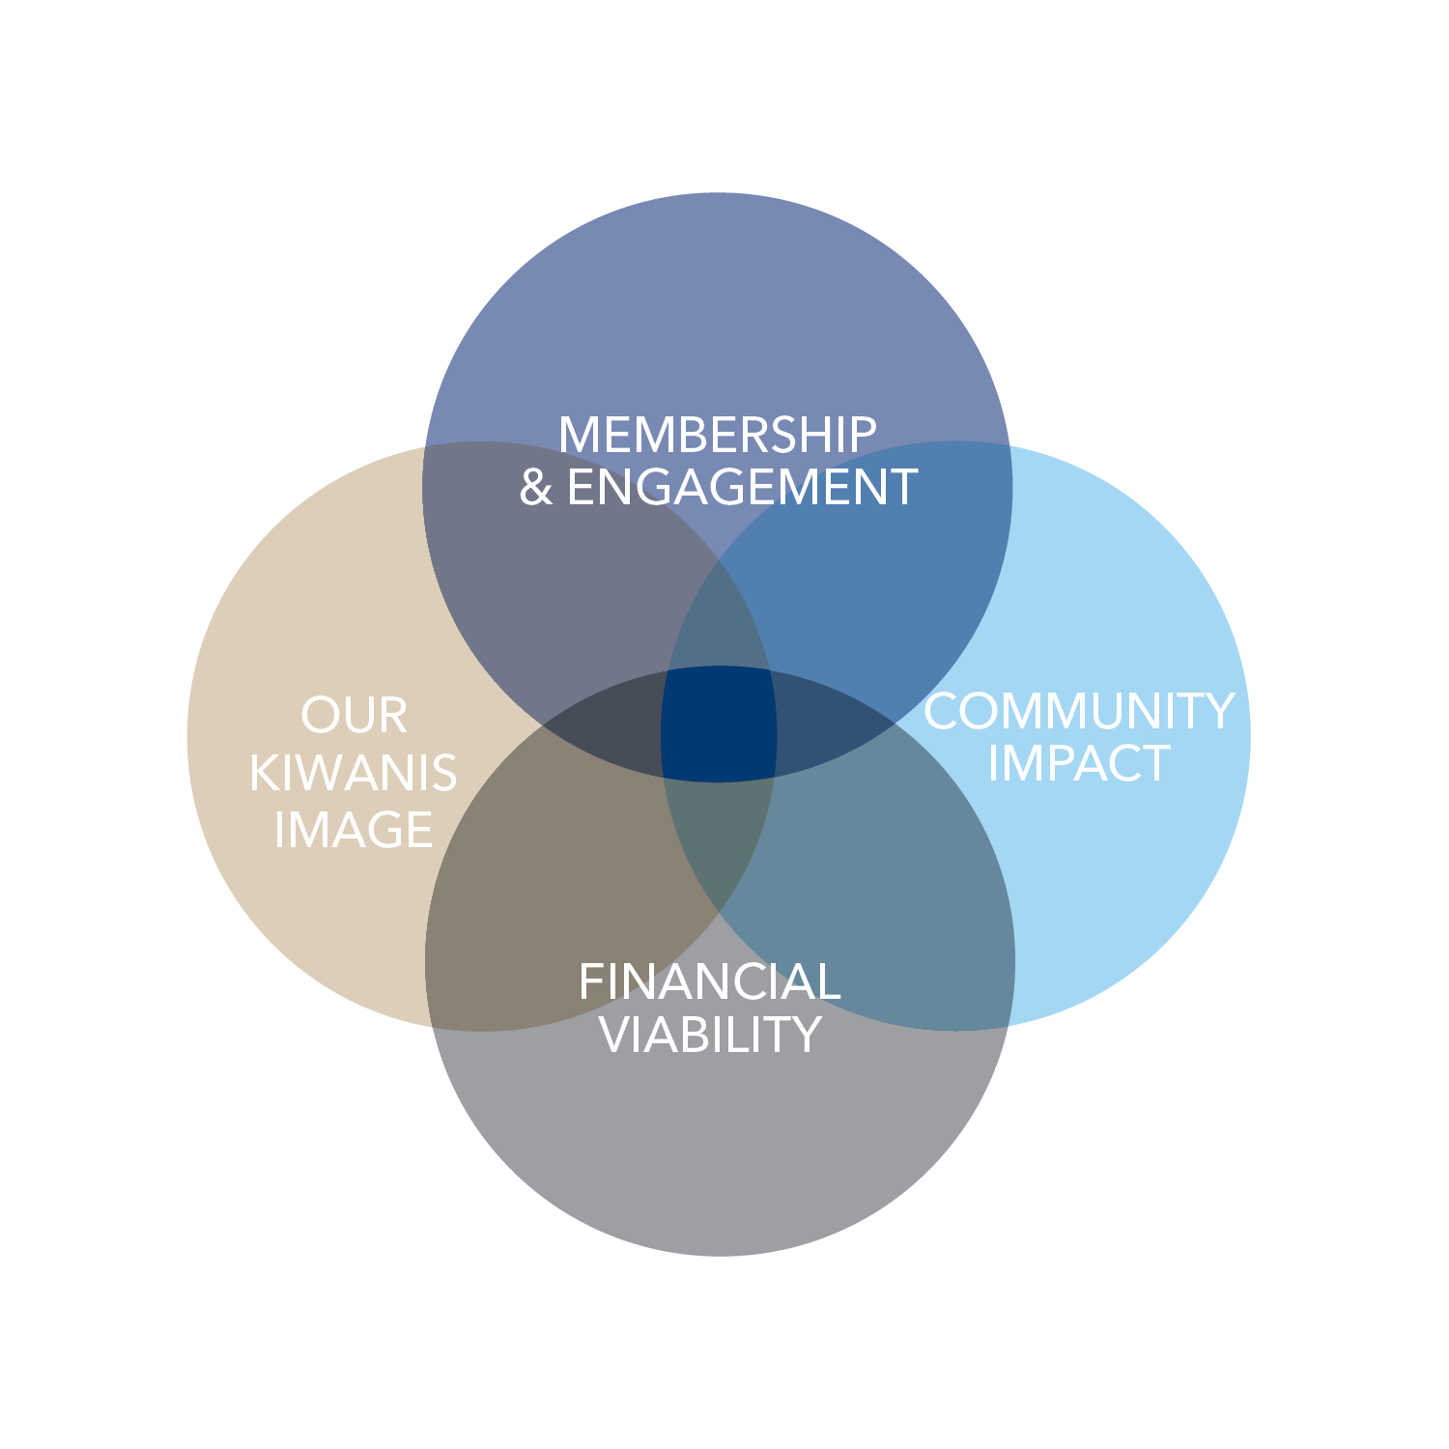
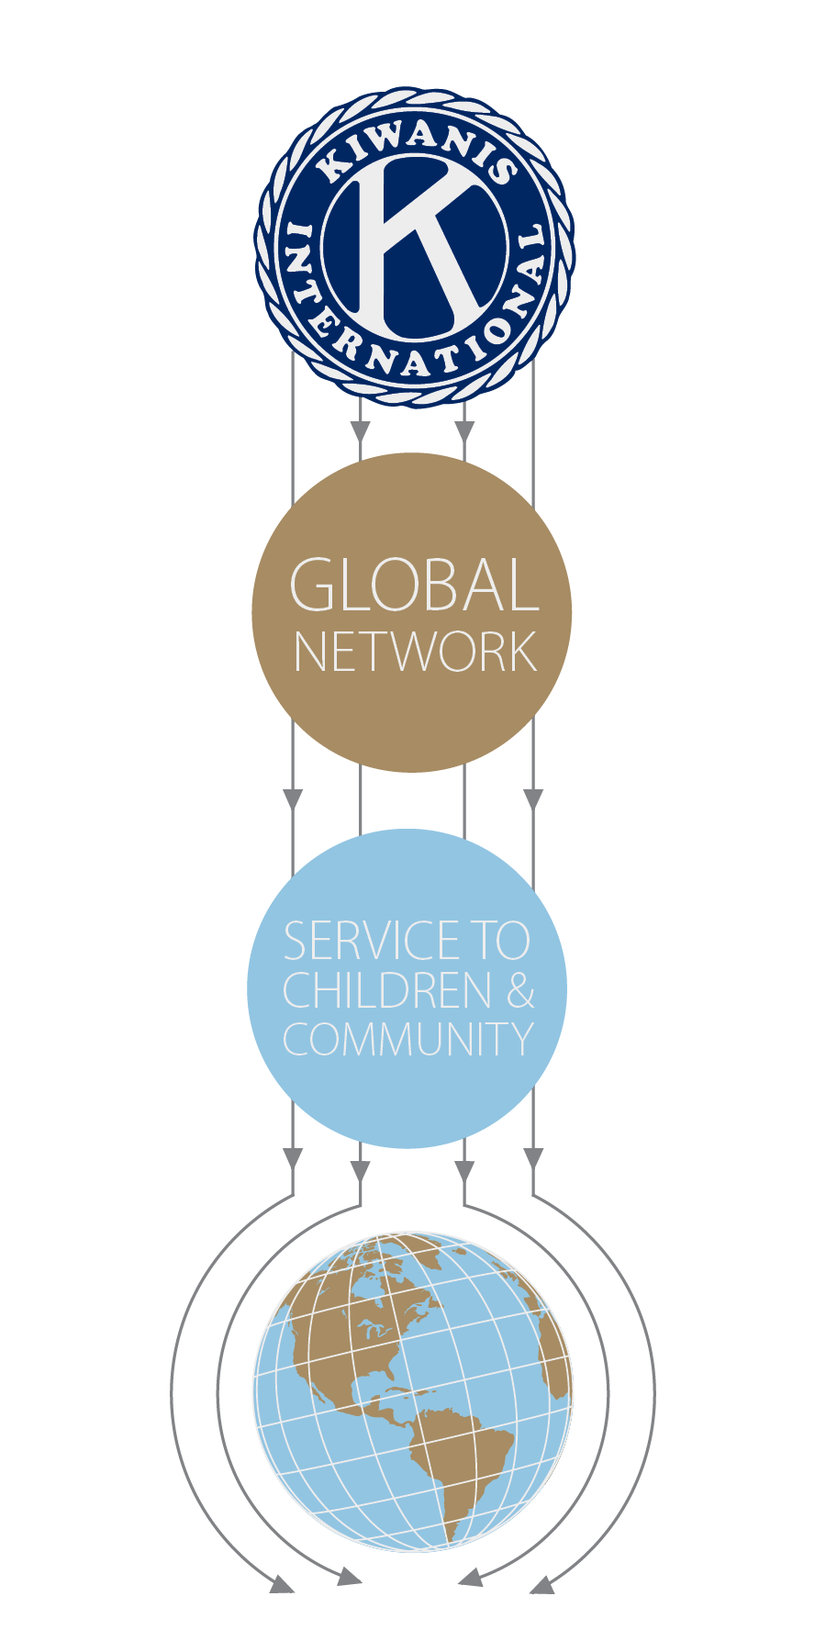
The four priority areas
Notes:
So here you have it, [CLICK]
Kiwanis International’s strategic plan; where all the priorities converge. This is where the magic happens. This is where Kiwanis becomes the catalyst for positive community change.
When we connect and collaborate with schools, hospitals, government, other nonprofits, corporations, foundations and others, Kiwanis—and the service we can provide to children—becomes an undeniable force for good in our communities. That means a bigger impact in the world. That means stronger communities that nurture their children.
And kids need Kiwanis.

Slide 27
Kiwanis International Strategic Plan
Thank you!

